Slide 1

SWE(cs425) -Final Project HopeBank
Desale Fessehaye Hdremariam 110595
Habtom Weldemichael Habte 610715
Mihreteab Tsegai Kidane 109583

Slide 2
Introduction And Problem statement
Bank of Hope a legacy bank.
Provides paper based legacy banking system
Saving
Checking
Credit
Mission
To add an online web-based feature
To handle the growing number of customers and coverage area.
To be more competitive

Slide 3
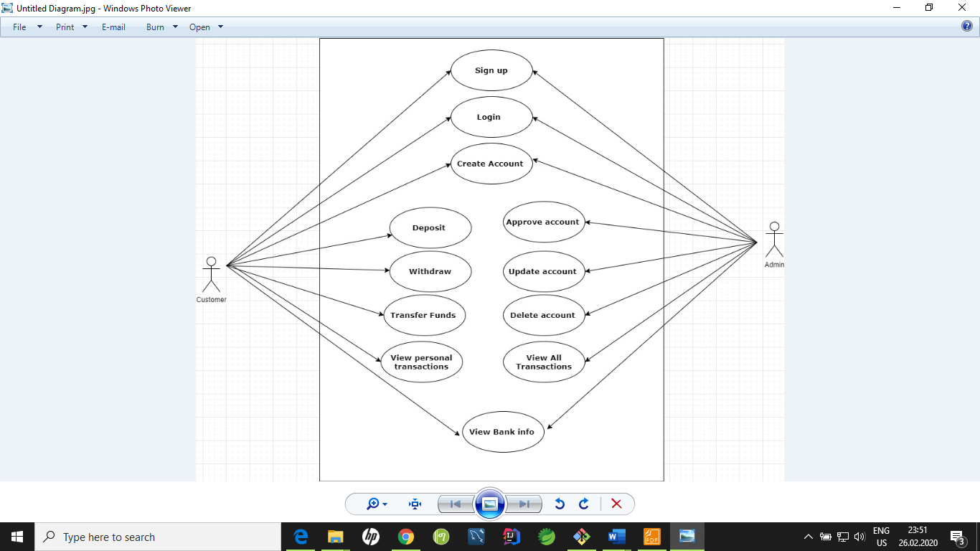
Use cases

Slide 4
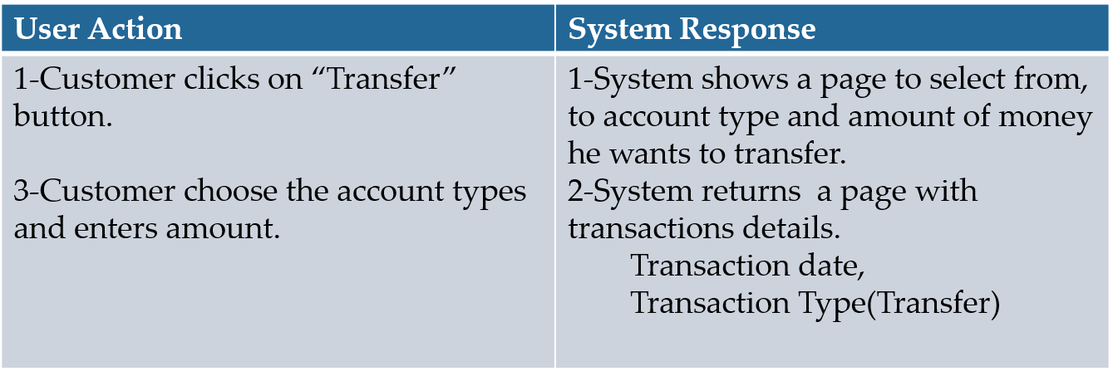
Transfer Money Use case
Name : Transfer funds
Description: This use case will allow user to transfer money between his accounts and to other people’s accounts.
Actor: Customer
Pre-condition: The customer has logged into the system.
Basic flow:

Slide 5
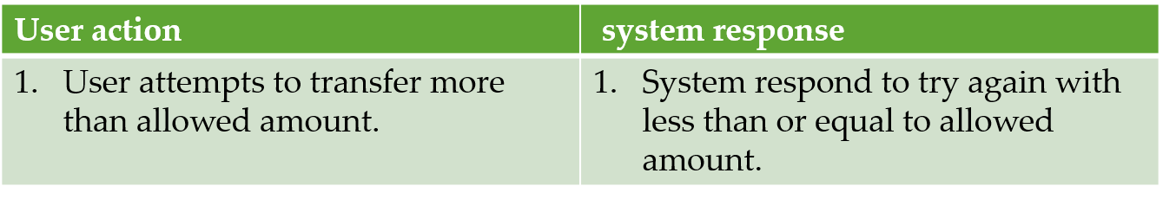
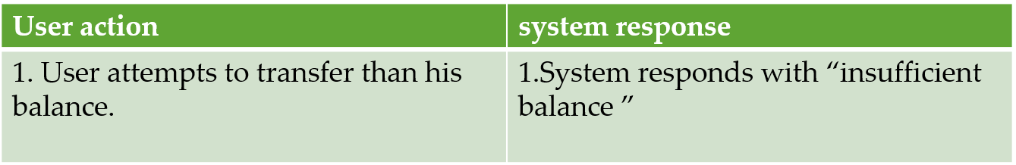
Post-condition: Money transaction persisted successfully.
Business rules:
The user must have enough balance to transfer.
Users must provide correct account details
User should not transfer more than $1000 per a day
Alternative flow :

Slide 6
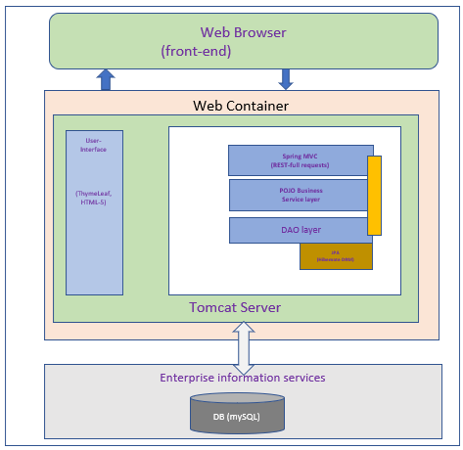






Enterprise Architecture Design

Slide 7
Register and Login security
Password matcher during registration
Password encryption
Checks username if exists at registration time

Slide 8
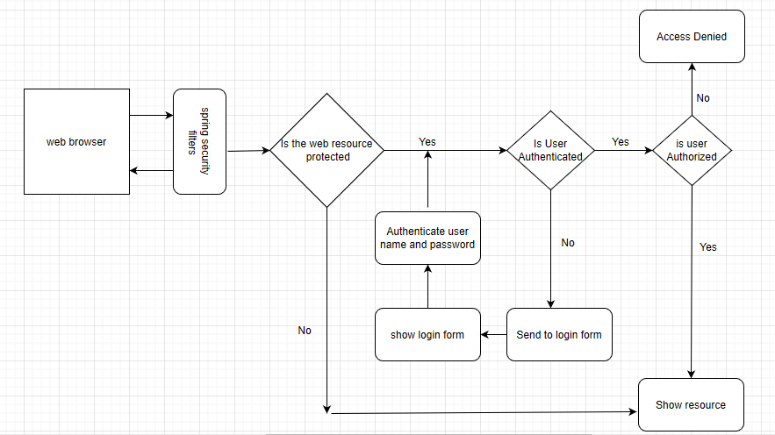
Security flow (Register, Login)

Slide 9
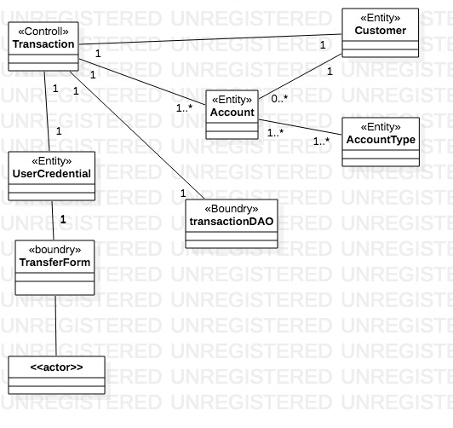
VOPC Diagram for transfer Scenario

Slide 10
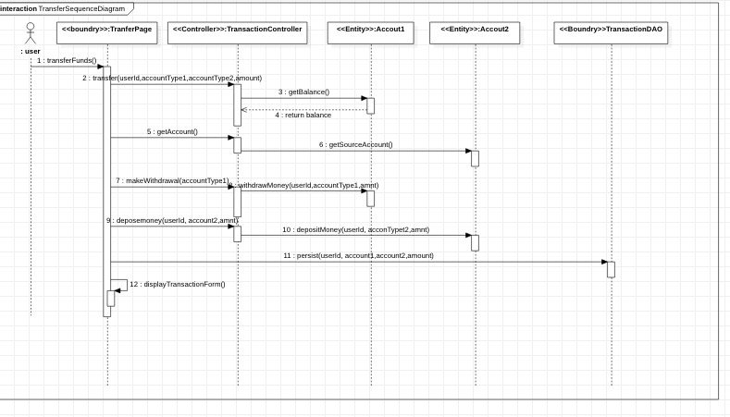
Sequence diagram for Transfer Scenario

Slide 11
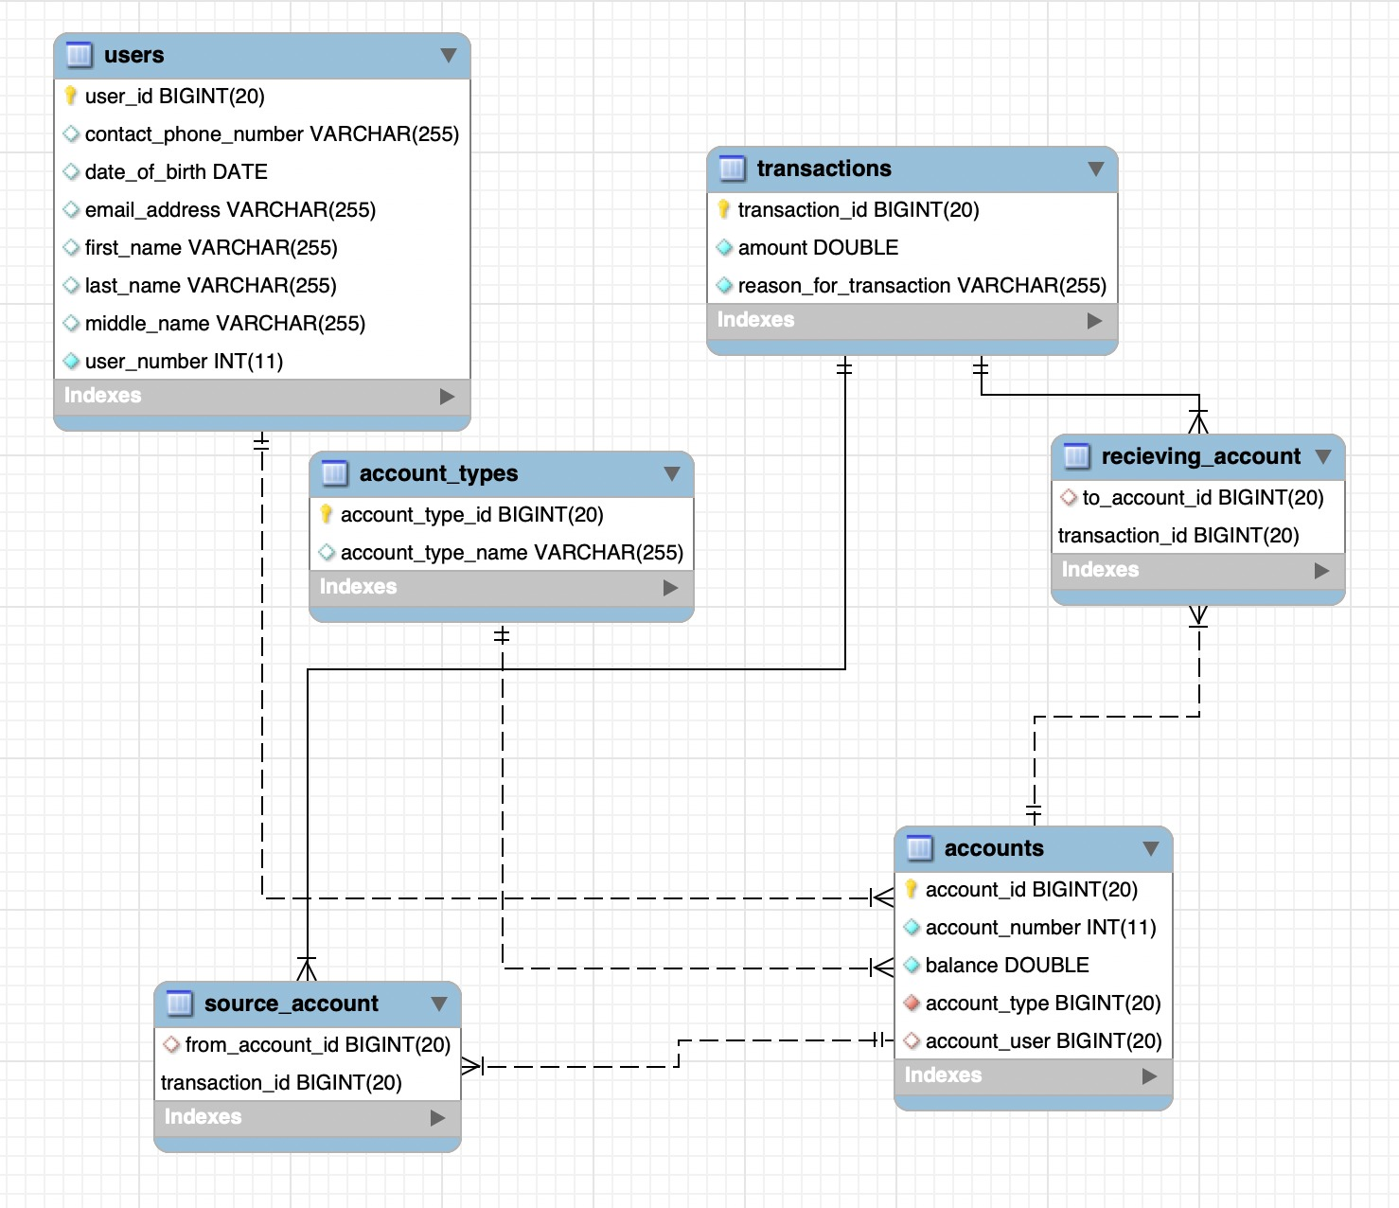
ER-Diagram

